Slide 1
Learning to Compare: Relation Network for Few-Shot Learning

Slide 2
Motivation
The “nearest neighbor” is found and its class is assigned to the unknown sample
Advantage:
simple and fast
Disadvantages:
The embedding is not general and can produce many false neighbors for the target domain
The distance metric is simple and will not account for the complexities of the embedding space

Slide 3
Motivation contd.
“RN”
Advantage:
The embedding is general and learned on a large set of data that enables it to be represented with a complex model with many parameters without overfitting.
Advantage:
The relation module is learned and is non-linear, allowing it to find matches that are better.

Slide 4
RN Methodology
RN uses three datasets: a training set, a support set and a testing set. The support set and testing set share the same labels. The labels in the training set are disjoint from the support and testing set. This is in contrast to typical supervised learning where the training, validation and test sets all share the same labels.
In C-way K-shot learning the training set contains C classes each of which has K examples.

Slide 5
RN Methodology contd.
As mentioned previously given a small training test a simple NN classifier can be used but the performance will be poor.
By leveraging the training set its information can be transferred to the RN and will result in better performance on the test set.
Episode based training is used to build mini-batches of examples that mimic the support/test set.
The mini-batches are constructed from a random set of C classes from the training set using K examples of each class. During each episode of the training a new set of C classes are used to form a Sample Set and a Query Set.

Slide 6
RN Methodology
The sample set and query set are used to adapt the parameters of the model during training by minimizing an objective function.
The sample set and the query set are selected from the training set to simulate the support and test sets.

Slide 7
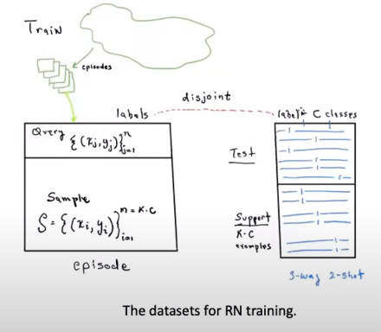
Dataset Structure
The labels in the training dataset are disjoint from those in Test/Support dataset.
Test/support sets share the same labels.
During training an episode is selected from the training data to simulate the Test/Support dataset.
The Sample data within the episode contains C classes each with K examples.
The Query data with the episode is also selected from the same C classes as the Sample data.

Slide 8
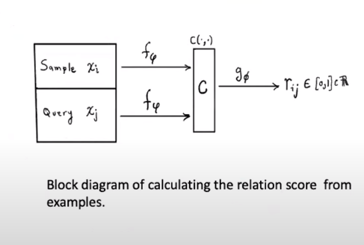
RN Module Transformation

Slide 9
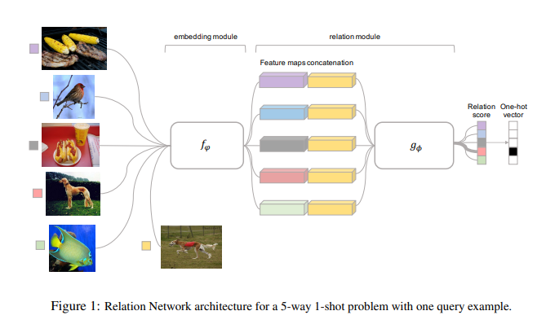
RN Classification example 5 way 1 shot
The sample set has C=5 classes each represented by K=1 example.
The query set has 1 example.
All images are embedded into a vector space. Each sample vector is then appended with the query vector.
The relation score is computed for each combined vector.
The relation score vector is 1-hot encoded to produce the best match.

Slide 10
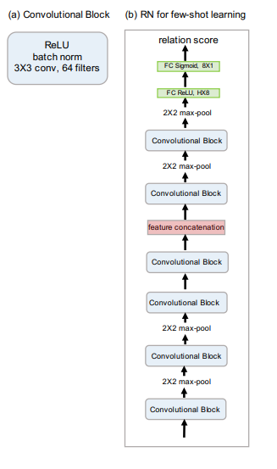
RN - Network Architecture
Images enter the network on the bottom of the block diagram on the right. Omniglot images are 32x32monochrome. Mini ImageNet images are 32x32x3 RGB.
The convolutional blocks contain 64 3x3 filters. After convolution a batch norm and RelU are performed.
The Embedding module consists of the four bottom blocks prior to feature concatenation.
The Relation module are the block following feature concatenation.
The size of the last 2x2 max-pool layer is H=64 for Omniglot and H=64*3*3 for mini ImageNet.
The next to last fully connected weights are Hx8 followed by a RelU.
The last fully connected weights are 8x1 followed by a sigmoid.

Slide 11
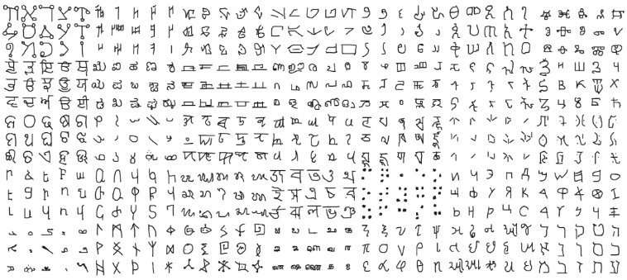
Datasets: omniglot
50 alphabets with 1623 total characters (classes)
Each character has 20 examples
1200 characters for training (Sample/Query)
423 characters for testing (Support/Test)
Experiments:
5-way 1-shot
5-way 5-shot
20-way 1-shot
20-way 5-shot
RN performed better than all pervious reported methods (except tied (within confidence interval) with MAML on S-way 5-shot)

Slide 12
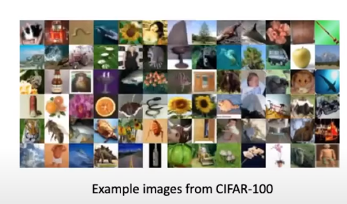
Datasets: mini imagenet
60,000 images from 100 classes
600 examples per class
64 classes for training
20 classes for testing
16 classes for validation (monitoring generalization only)
Experiments:
5-way 1-shot
5-way S-shot
RN performed better than all pervious reported methods for 5-way 1-shot,competitive on 5-way 5-shot

Slide 13
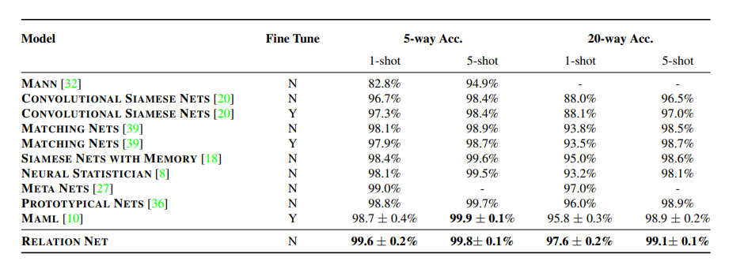
Omniglot – experimental results

Slide 14
Why relational networks?
RN is both a deep embedding and a deep non-linear metric.
Rather than choose a metric such a Euclidean, cosine or Mahalanobisthe metric is learned from the training data.
By learning the deep embedding simultaneously with the deep non-linear metric the RN can better identify matched/mismatched pairs.

Slide 15
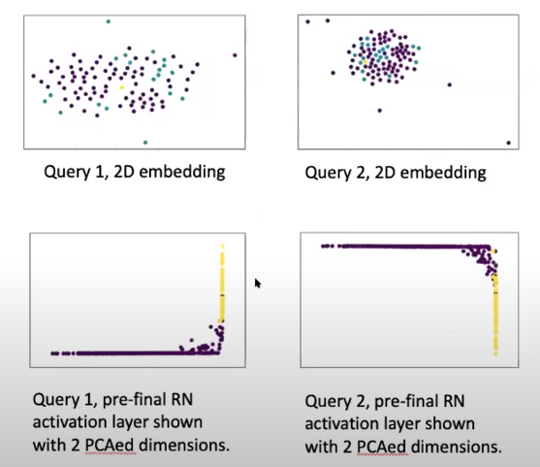
Visualization
On the top we embed images from Omniglot into a two dimensional vector space by using PCA.
The yellow circle is the query image
The cyan circles are matching images
The magenta circles are mismatched images
Note that is would be difficult to classify the images correctly using a simple metric Sach as Euclidian
On the bottom we display the penultimate activation layer of the relation network PCAed to 2 dimensions
Queries are yellow and samples are magenta
Here this space can now be linearly separated by the final layer of the RN

Slide 16
Conclusion
RN was proposed to do C-way K-shot learning
The RN learns an embedding and a deep non-linear metric for comparing query and sample objects.(Episode training is used)
RN is simpler and more efficient that other C-way K-shot methods.
It is state-of-the art.

